Slide 1
OTHER TWO- L EVEL IMPLEMENTATIONS:
The types of gates most often found in integrated circuits are NAND and NOR gates.
For this reason, NAND and NOR logic Implementations are the most important from a practical point of view. Some (but not all) NAND or NOR gates allow the possibility of a wire connection between the outputs of two gates to provide a specific logic function.
This type of logic is called wired logic. For example, open-collector TTL NAND gates, when tied together, perform wired-AND logic.

Slide 2
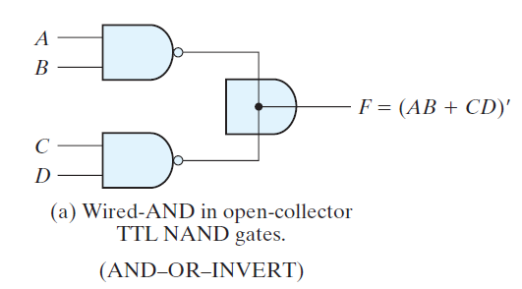
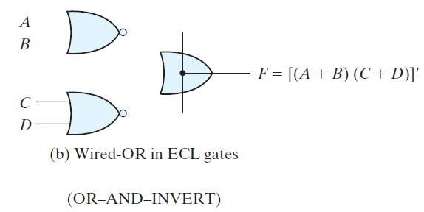
The logic function implemented by the above circuit is
F = (AB)‘.(CD)‘ = (AB + CD)‘ = (A‘ + B‘)(C‘ + D‘)
and is called an AND–OR–INVERT (AOI) function.
Similarly, the NOR outputs of ECL gates can be tied together to perform a wired-OR function.
The logic function implemented by the circuit of Fig. (b) is
F = (A + B)’+ (C + D)’ = [(A + B)(C + D)]’
and is called an OR–AND–INVERT (OAI) function.

Slide 3
A wired-logic gate does not produce a physical second-level gate, since it is just a wire connection. For discussion purposes, we will consider the above circuits as two-level implementations. The first level consists of NAND (or NOR) gates and the second level has a single AND (or OR) gate.
Nondegenerate Forms:
We consider four types of gates: AND, OR, NAND, and
NOR. If we assign one type of gate for the first level and one type for the second level, we find that there are 16 possible combinations of two-level forms. (The same type of gate can be in the first and second levels, as in a NAND–NAND implementation.)

Slide 4
Eight of these combinations are said to be degenerate forms because they degenerate to a single operation. This can be seen from a circuit with AND gates in the first level and an AND gate in the second level. The output of the circuit is merely the AND function of all input variables.
The remaining eight nondegenerate forms produce an implementation in sum-of-products (SOP) form or product-of-sums (POS) form.
The eight nondegenerate forms are as follows:
AND–OR, OR–AND
NAND–NAND, NOR–NOR
NOR–OR, NAND–AND
OR–NAND, AND–NOR

Slide 5
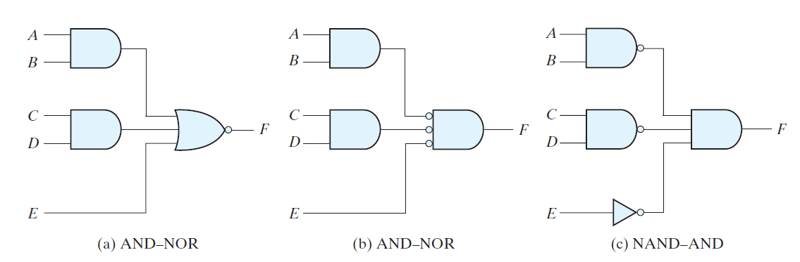
AND–OR–INVERT (AOI) Implementation:
The two forms, AND–NOR and NAND–AND, are equivalent and can be treated together. Both perform the AND–OR–INVERT function, as shown in the following Fig. The AND–NOR form resembles the AND–OR form, but with an inversion done by the bubble in the output of the NOR gate.
It implements the function: F = (AB + CD + E)’

Slide 6
An AND–OR implementation requires an expression in sum-of-products form.
The AND–OR–INVERT implementation is similar, except for the inversion.
Therefore, if the complement of the function is simplified into sum-of-products form (by combining the 0’s in the map), it will be possible to implement F’ with the AND–OR part of the function.
When F’ passes through the always present output inversion (the INVERT part), it will generate the output F of the function.

Slide 7
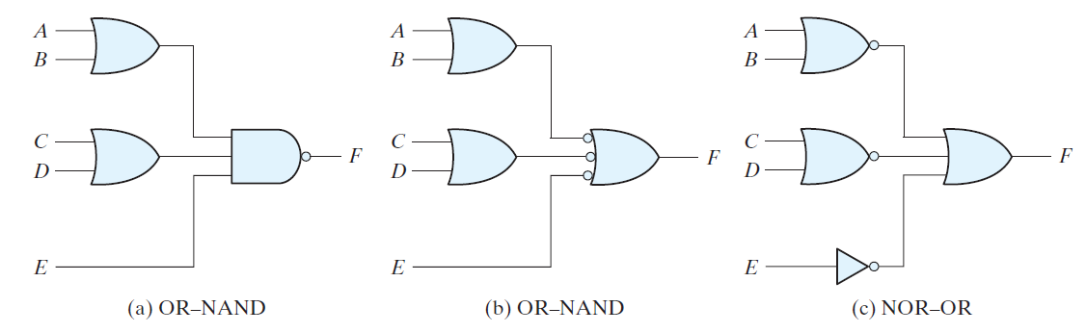
OR–AND–INVERT (OAI) Implementation:
The OR–NAND and NOR–OR forms perform the OR–AND–INVERT function, as shown in the following Fig. The OR–NAND form resembles the OR–AND form, except for the inversion done by the bubble in the NAND gate.
It implements the function F = [(A + B)(C + D)E]’

Slide 8
The OR–AND–INVERT implementation requires an expression in product-of-sums form.
If the complement of the function is simplified into that form, we can implement F’ with the OR–AND part of the function.
When F’ passes through the INVERT part, we obtain the complement of F’, or F , in the output.

Slide 9
Tabular Summary and Example:
Following Table summarizes the procedures for implementing a Boolean function in any one of the four 2-level forms.
Because of the INVERT part in each case, it is convenient to use the simplification of F’ (the complement) of the function.
When F’ is implemented in one of these forms, we obtain the complement of the function in the AND–OR or OR–AND form.
The four 2-level forms invert this function, giving an output that is the complement of F’.
This is the normal output F.

Slide 10
